Slide 1
Management for Trauma Patient in Taiwan Emergency Department
Dr. Cloud Wu Taiwan Medical Mission
Taipei Municipal Wanfang Hospital Emergency Department
Notes:
基本上是 Non traumatic shock

Slide 2
Step by Step
Preparation
Triage
Primary survey (ABCDEs) with immediate resuscitation of patients with life-threatening injurys
Adjuncts to the primary survey and resuscitation
Consideration of the need for patient transfer
Secondary survey (head-to-toe evatluation and patient history)
Adjuncts to the secondary survey
Continued post-resuscitation monitoring and reevaluation
Definitive care

Slide 3
Prepare
Equipment
Resuscitation area
Trauma team

Slide 4
Prehospital/Field triage
GCS, vital sign
Injury site / type
Penetrating / Crush / blunt
Pelvic, chest, long bone >2
Open / closed / amputation
Mechanism
Fall > 6m (2 floor)
High energy (Highway)
Gun Shot Wound (GSW)
Stabbing wound
Specific group
Elder, Children, Pregnancy
Specific hx: coagulopathy

Slide 5
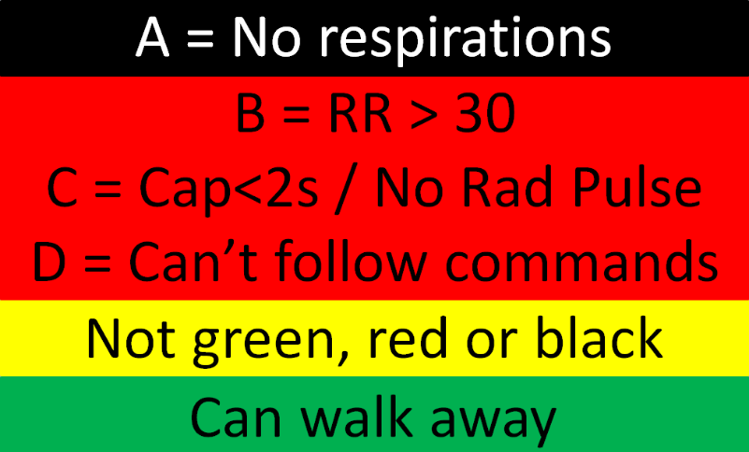
Prehospital/Field triage
Simple Triage and Rapid Treatment (START)
紅：Immidiate 黃：Delayed 綠：Minnor 黑：Deceased

Slide 6
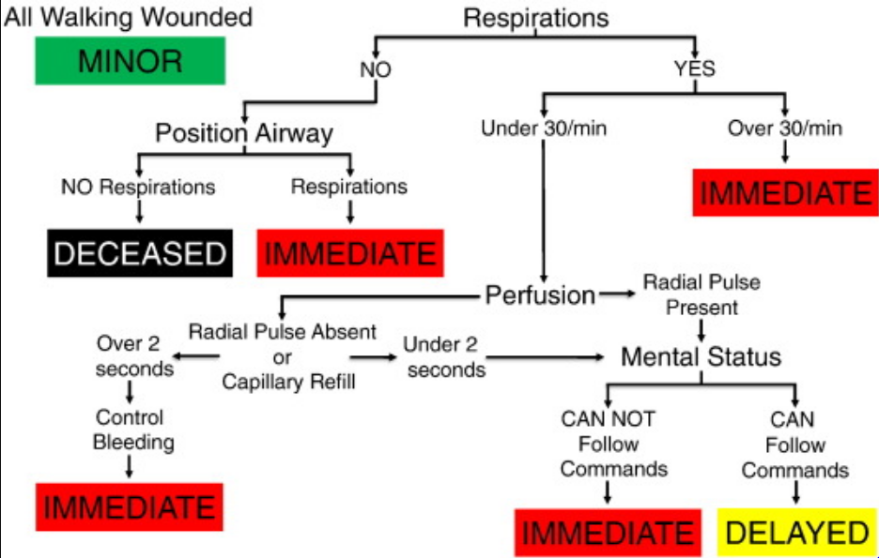

Slide 7
Triage
Order of treatment is based on the ABC priorities
Airway with cervical spine protection
Breathing
Circulation with hemorrhage control

Slide 8
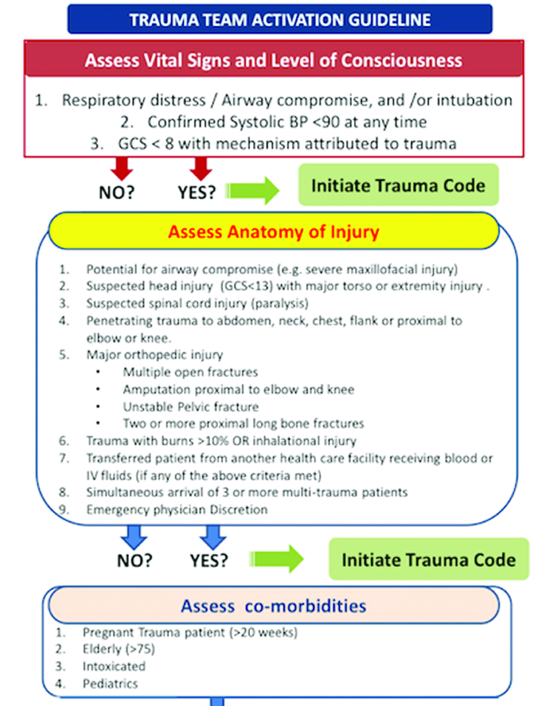

Slide 9
Primary ABCDE
Airway maintenance with restriction of cervical spine motion
Breathing and ventilation
Circulation with hemorrhage control
Disability(assessment of neurologic status)
Exposure/Environmental control

Slide 10
10 sec assessment
10 secs quickly assess A, B, C, and D in a trauma patient
asking the patient for his or her name
asking what happened
If the patient can answer clearly(GCS fine and no severe airway or breathing compromise)
Manage and assess at the same time

Slide 11
Airway
Inspecting for foreign bodies
Identifying facial, mandibular, tracheal/laryngeal fractures
Frequent reevaluation of airway patency is essential
Intubation
GCS < 8 or nonpurposeful motor responses -> consider ETT
remove neck collar temporally but need someone stable head and neck
Surgical airway
intubation is contraindicated or cannot be accomplished

Slide 12
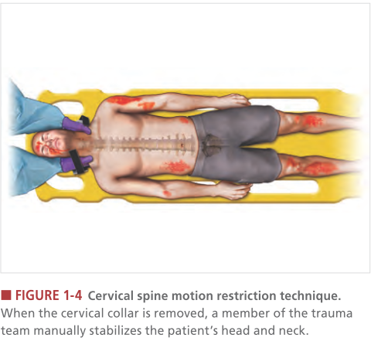

Slide 13
Breathing/Ventilation
Expose the patient’s neck and chest
Inspection: trachea deviation, chest trauma, jugular venous distention
Auscultation: decreased, absent
Percussion/Palpation: subcutaneous emphysema
Tension pneumothorax
Notes:
Simple pneumothorax, simple hemothorax, fractured ribs, flail chest, and pulmonary contusion can compromise ventilation to a lesser degree and are usually identified
during the secondary survey.

Slide 14
Circulation
level of consciousness, skin perfusion, and pulse
Sonography for trauma [FAST], or diagnostic peritoneal lavage
Bleeding
Direct compression
tourniquet only when direct pressure is not effective and the patient’s life is threatened
Hypovolemic shock
2 large bore line
A bolus of warmed 1L of an isotonic solution may be required to achieve an appropriate response
should receive a blood transfusion if no response
Notes:
Tourniquets are effective in massive exsanguination from an extremity but carry a risk of ischemic injury to that extremity

Slide 15
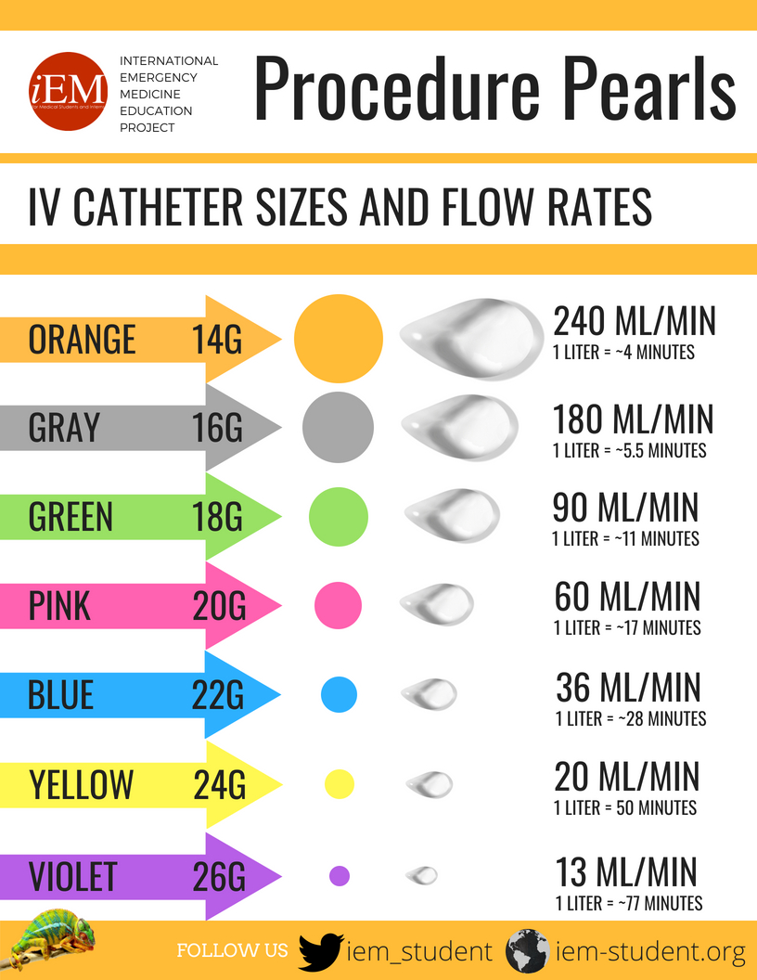
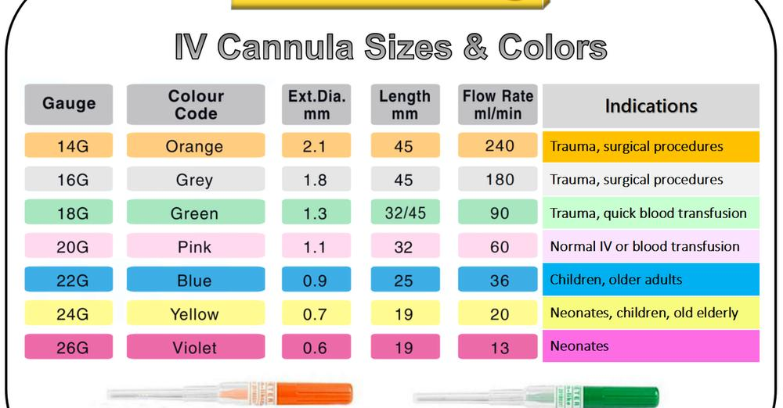
2 large bore line
Notes:
Tourniquets are effective in massive exsanguination from an extremity but carry a risk of ischemic injury to that extremity

Slide 16
Circulation
Poor conscious : check carotid artery
Conscious alert : check radial artery
Neck : 50-60 mmHg Femoral : 70 mmHg Radius : 80 mmHg Dorsalis pedis : 90 mmHg
Notes:
Tourniquets are effective in massive exsanguination from an extremity but carry a risk of ischemic injury to that extremity

Slide 17
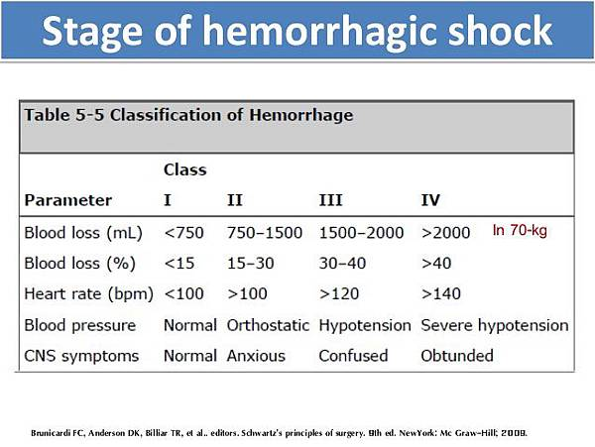
Notes:
Tourniquets are effective in massive exsanguination from an extremity but carry a risk of ischemic injury to that extremity

Slide 18
Massive Transfusion Protocol
Definition
> 10 units of pRBCs within the first 24 hours
> 4 units of pRBCs in 1 hour
Damage control resuscitation (severe trauma, massive blood replacement) 1:1:1 (FFP:platelets:pRBCs)

Slide 19
Disability
Level of consciousness Pupillary size Reaction
Prevention of secondary brain injury
maintaining adequate oxygenation and perfusion are the main goals of initial management

Slide 20
Exposure / Environment
Undress
Avoid hypothermia
high-flow fluid warmer 39’C
microwave can be used to warm crystalloid fluids

Slide 21
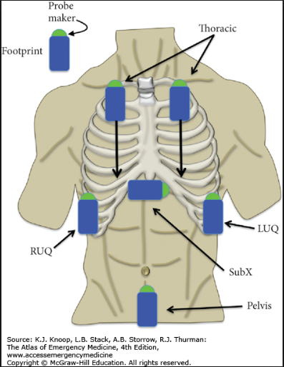
Sonography in Primary survey
E-FAST

Slide 22
Monitors
ECG
Blunt cardiac injury, Tamponade, pneumothorax, hypovolemia, hypothermia
Pulse oximeter
Consider Foley
do not insert a urinary catheter before examining the perineum and genitalia
Consider NG
decompress stomach distention
decrease the risk of aspiration,
check for upper gastrointestinal hemorrhage from trauma
Notes:
Urethral injury is suspected, confirm urethral integrity by performing a retrograde urethrogram before the catheter is inserted.
NG is indicated to decompress stomach distention, decrease the risk of aspiration, and check for upper gastrointestinal hemorrhage from trauma

Slide 23
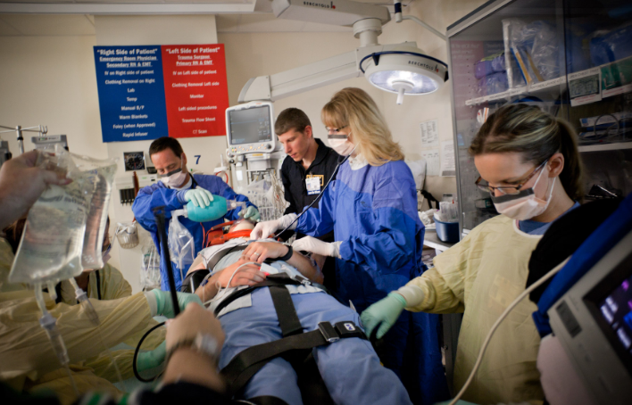
Team work

Slide 24
Secondary Assessment
Head-to-toe, every hole
Complete history and physical examination
Reassessment of all vital signs
Other examination
X-ray, CT

Slide 25
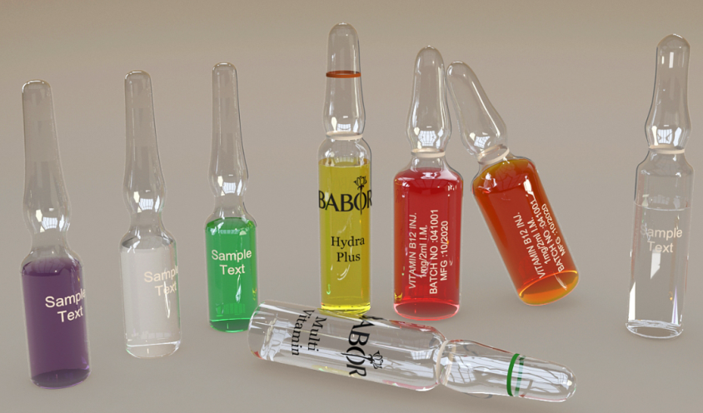
AMPLE history
Allergies
Medications currently used
Past illnesses/Pregnancy
Last meal
Events/Environment related to the injury

Slide 26
Injury Severity Score, ISS
50% mortality rate： 15~44y/o，ISS=40 45~64 y/o，ISS=29 >65y/o，ISS=20

Slide 27
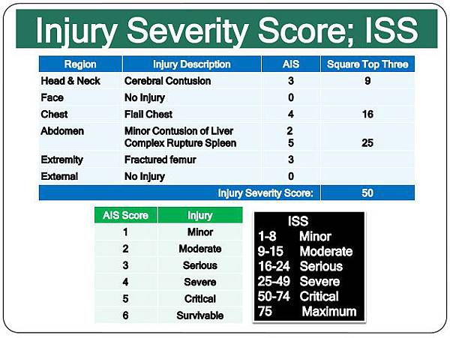

Slide 28
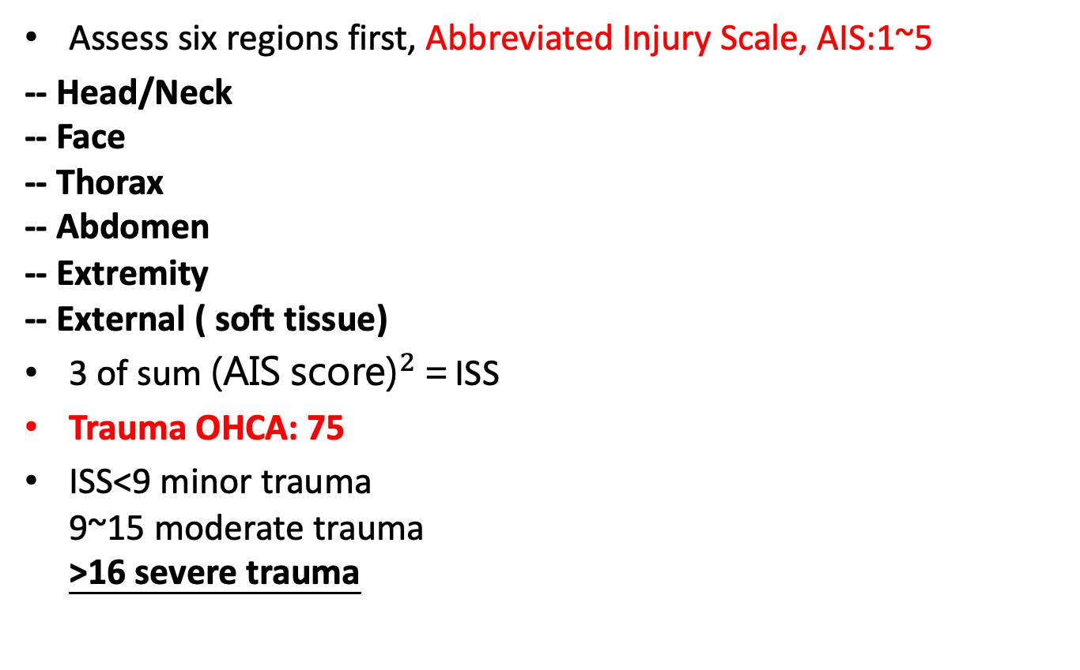
Injury Severity Score, ISS
Assess six regions first, Abbreviated Injury Scale, AIS:1~5
-- Head/Neck -- Face -- Thorax -- Abdomen -- Extremity -- External ( soft tissue)
3 of sum ${\text{(}\text{AIS} \text{score}\text{)}}^{2}$＝ISS
Trauma OHCA: 75
ISS<9 minor trauma 9~15 moderate trauma >16 severe trauma

Slide 29
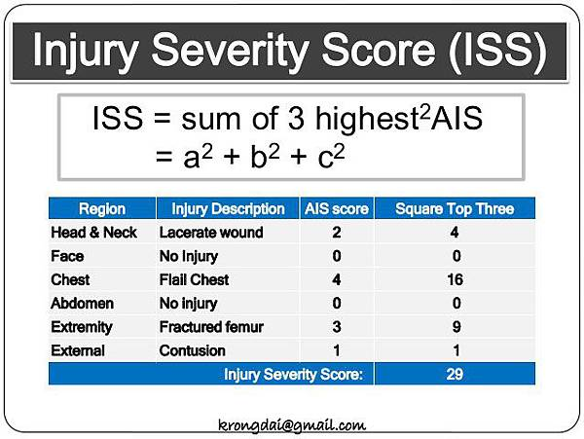

Slide 30
Penetrating Wound Management
Management of thoracoabdominal (low chest) stab wound
Management of impalement instrument in situ
How to assess peritoneal violation in GSW
WEST 2018 Abdominal Stab Wound Algorithm

Slide 31
Overview
Management of penetrating trauma is based on the type and location of the injury. First based on ATLS algorithm
Types: Stab, GSW
Penetrating chest/ abdominal trauma
Penetrating thoracoabdominal and flank trauma
Diaphragmatic injury

Slide 32
Stab Wounds
Etiology: ∼ 1500 people die from stab wounds annually in US
Mechanism of injury Caused by the thrusting action of a pointed object (e.g., knife, broken bottle)
The depth of the injury is usually greater than the width.
Only remove impaled foreign bodies (e.g., knives) in settings where definitive hemostatic control is possible (e.g., operating room) as they might be tamponading injured blood vessels

Slide 33
Gunshot wounds (GSWs)
Etiology: Mortality rate in the US is 10.2 per 100,000 adults.
Mechanism of injury
Tissue is lacerated and crushed along the path of the bullet.
Tissue is displaced forward and radially, resulting in cavitation and pressure injury of nearby structures.
The level of injury is related to the kinetic energy of the bullet; energy varies based on factors such as bullet weight and velocity.
Dense organs (e.g., liver, bone) absorb more kinetic energy than less dense organs, resulting in greater injury.

Slide 34
Location | Injury | Managemnt
Neck | ﻿﻿Tracheobronchial injury ﻿﻿Esophageal injury ﻿﻿Vascular injury (e.g., carotid artery, vertebral artery, jugular vein) ﻿﻿Cranial nerve injury (e.g., vagus nerve, recurrent laryngeal nerve) ﻿﻿Pneumothorax | Approach to penetrating neck trauma
Chest | ﻿﻿Cardiac tamponade ﻿﻿Hemothorax ﻿﻿Pneumothorax ﻿﻿Tracheobronchial injury ﻿﻿Diaphragmatic injury ﻿﻿Spinal cord injury ﻿﻿Fractures (e.g., rib fractures, vertebral fractures) ﻿﻿Vascular injury (e.g., aorta, vena cava) | Approach to penetrating chest trauma
Abdomen and Pelvis | ﻿﻿Diaphragmatic injury ﻿﻿Hollow viscus perforation ﻿﻿Solid organ injury (e.g., liver, spleen) ﻿﻿Genitourinary trauma | Approach to penetrating abdomen trauma
Extremity | ﻿﻿Neurovascular iniury ﻿﻿Fracture ﻿﻿Compartment syndrome | Approach to penetrating extremities trauma

Slide 35
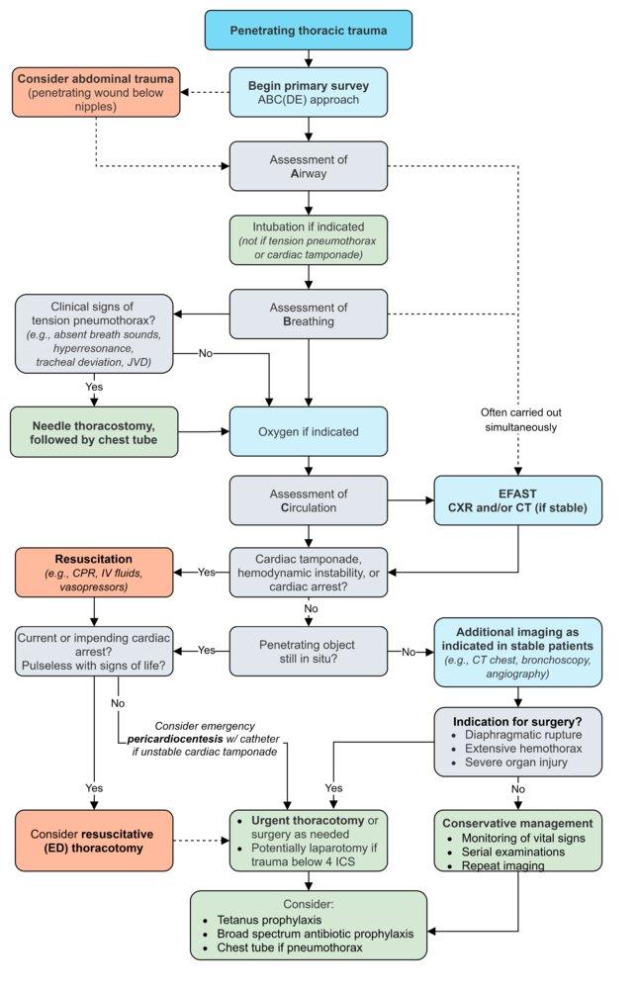

Slide 36
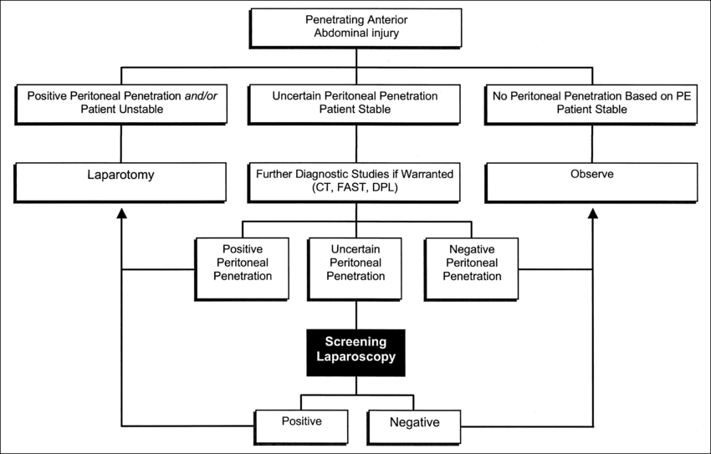

Slide 38
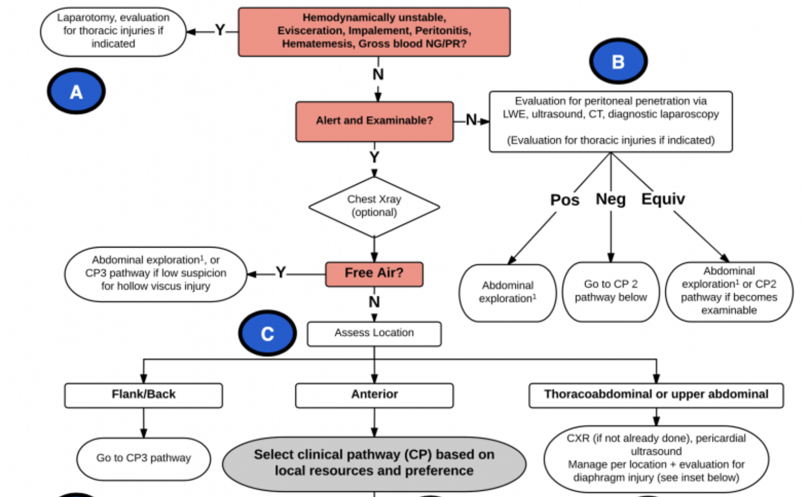

Slide 39
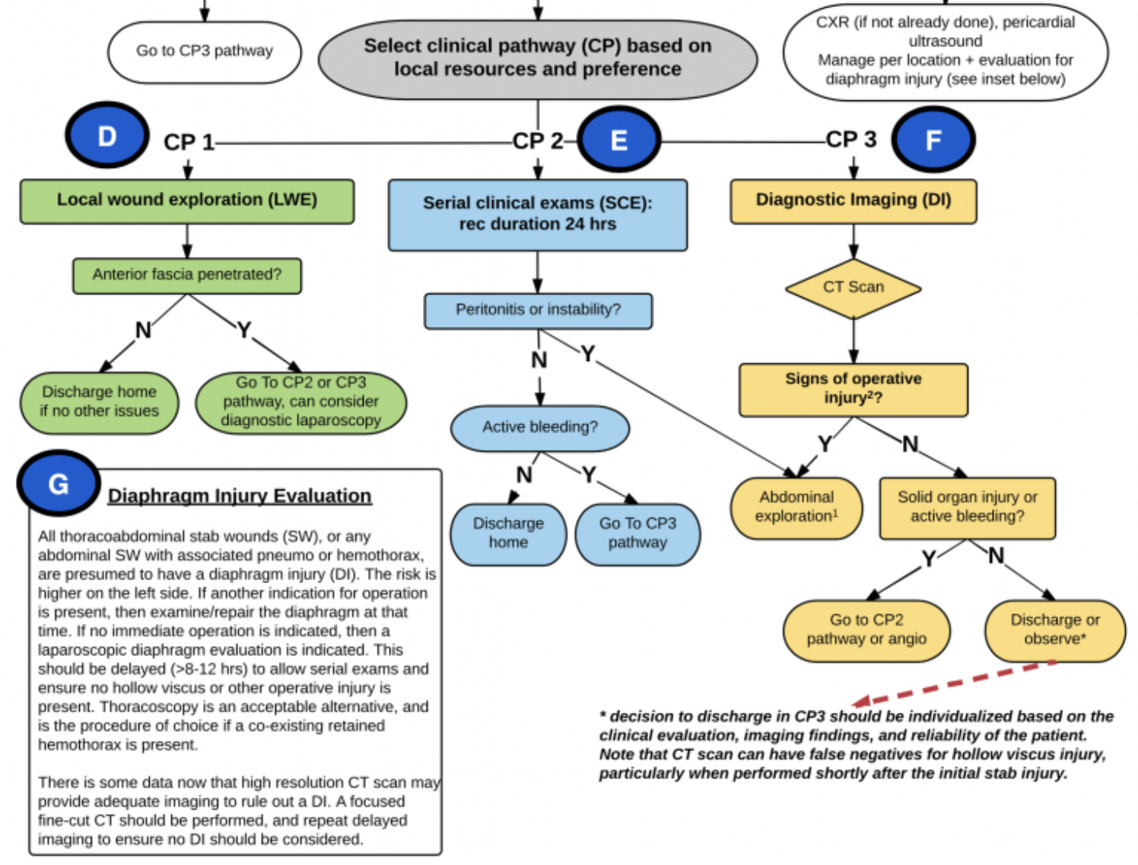

Slide 40
Diaphragm Injury Evaluation
All thoracoabdominal stab wounds (SW), or any abdominal SW with associated PTX,HTX, are presumed to have a diaphragm injury (DI).
The risk is higher on the left side.
If another indication for OP is present, then examine/repair the diaphragm at that time.
If no immediate OP indicated, then a laparoscopic diaphragm evaluation is indicated.
This should be delayed (>8-12 hrs) to allow serial exams and ensure no hollow viscus or other operative injury is present.
Thoracoscopy is the procedure of choice if a co-existing retained HTX is present.
CT provides adequate imaging to rule out DI, and repeat delayed imaging should be considered.

Slide 41
Summary
Trauma triad with simple triage and rapid treatment
ABCDE
Secondary survey
ISS/AIS
Penetrating Wound Management

Slide 42
Thank you

